Slide 1


Sales & revenue analysis dashboard For (periyar nagar branch)
Analyzing Sales, Orders, and Expenses
for financial year 2023

Slide 2
objective of the project
Analyze Sales Trends: Explore historical sales data to identify trends, patterns, and seasonal variations in sales volume and revenue.
Understand Customer Behavior: Segment customers based on visit frequency, total orders, and total spending to understand their preferences and behavior.
Evaluate Product Performance: Assess the performance of different product categories, sub-categories, and individual products to identify best-sellers and opportunities for product optimization.
Analyze Revenue Components: Break down total revenue into its components such as total amount, discount amount, and tax amount to understand their impact on overall profitability.
Visualize and Report Insights: Create interactive dashboards and reports to present key insights and findings in a clear and actionable manner for stakeholders.

Slide 3
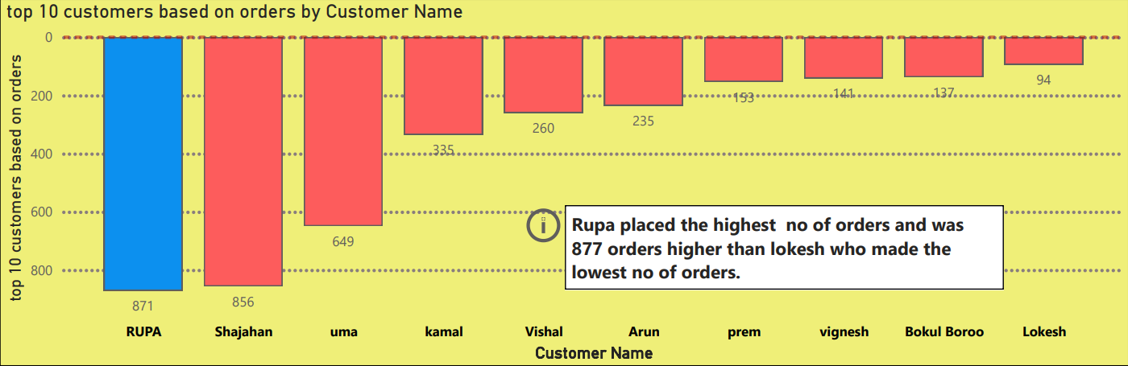
Top 10 Customers Based on Orders

Slide 4
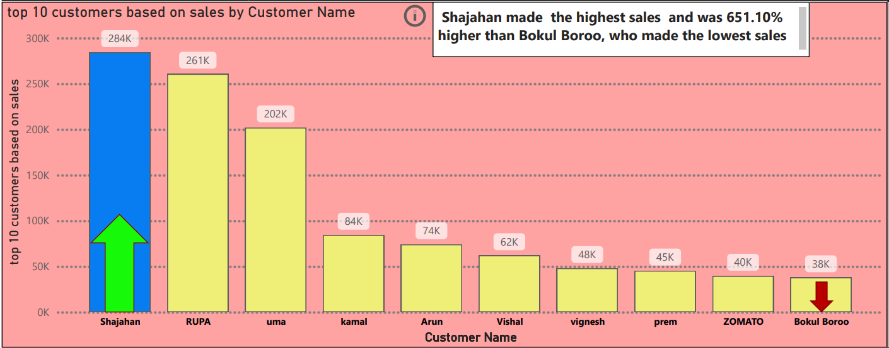
Top 10 Customers Based on Sales

Slide 5
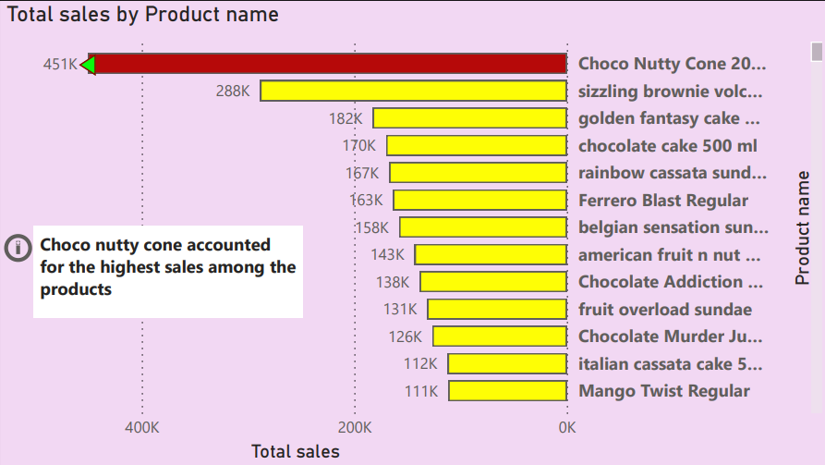
Top Products by Sales

Slide 6
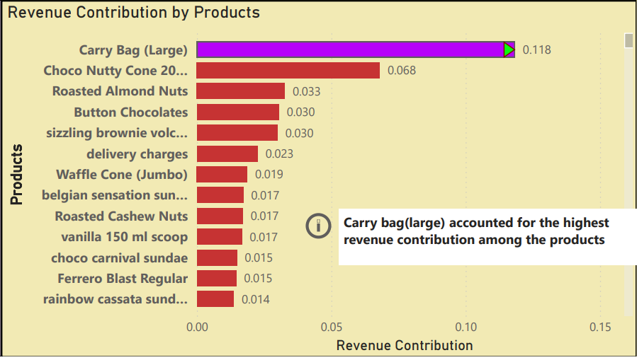
Revenue Contribution by Products

Slide 7
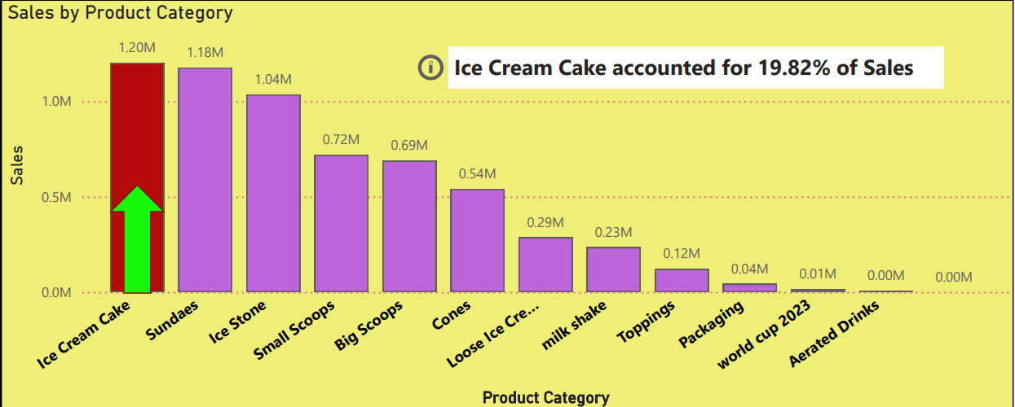
Sales by Product Category
Product categories:
* ice cream cakes
* sundaes
* ice stone
* small & big
scoops
* cones
* loose ice cream
* milk shake
* toppings

Slide 8
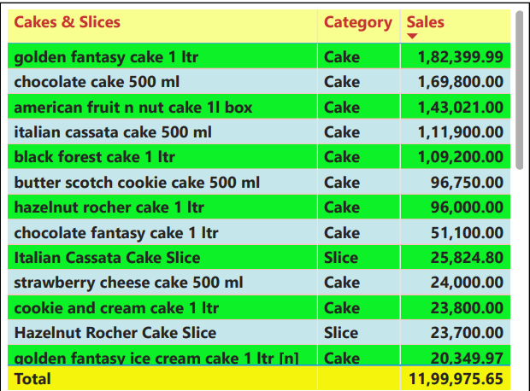
Cakes ad slices category wise sales
Key insight:
In the cake category- golden fantasy cake 1 litre has the highest sales.
In the slices category- Italian cassata cake slice has the highest sales.

Slide 9
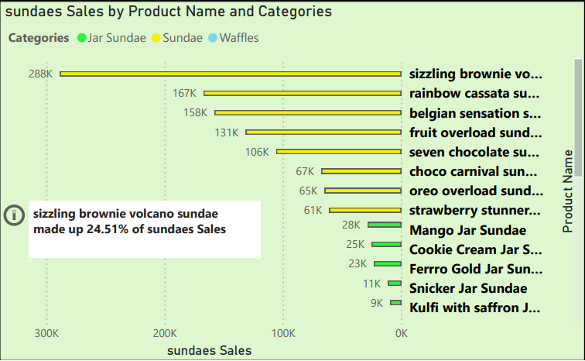
In the sundaes category – sizzling brownie volcano made the highest sales of 288k

Slide 10
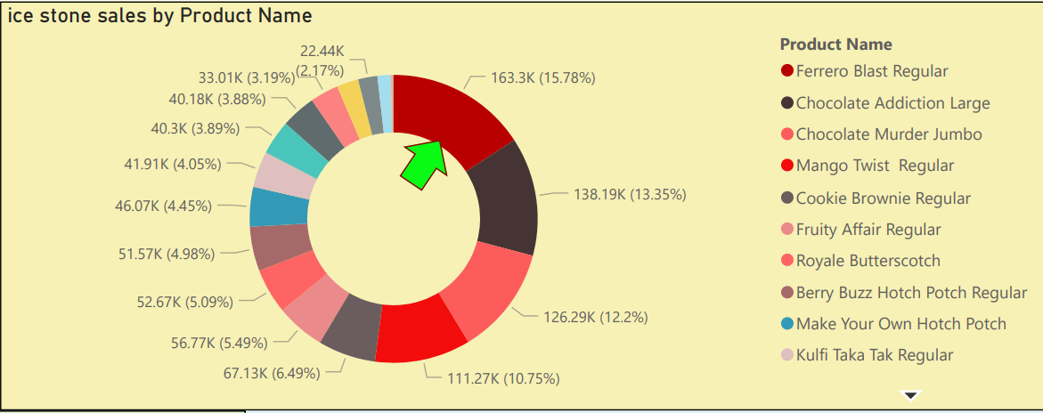
In the ice stone category – ferrero blast regular made the highest sales

Slide 11
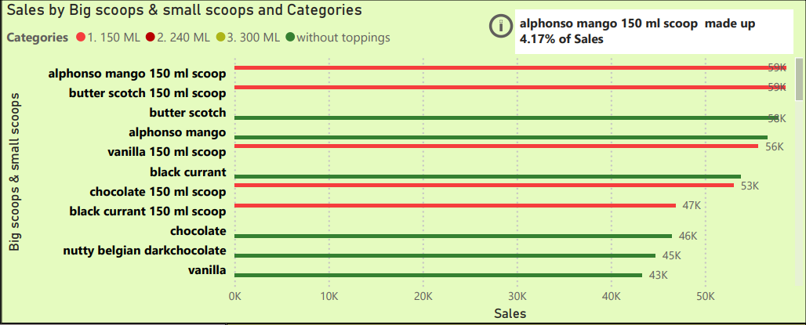
In the big scoops and small scoops category –alphonso mango and butterscotch scoops made the highest no of sales.

Slide 12
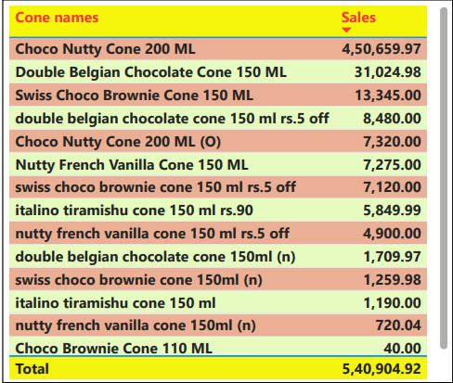
In the cone category – choco nutty cone 200 ML had the highest sales of 450k

Slide 13
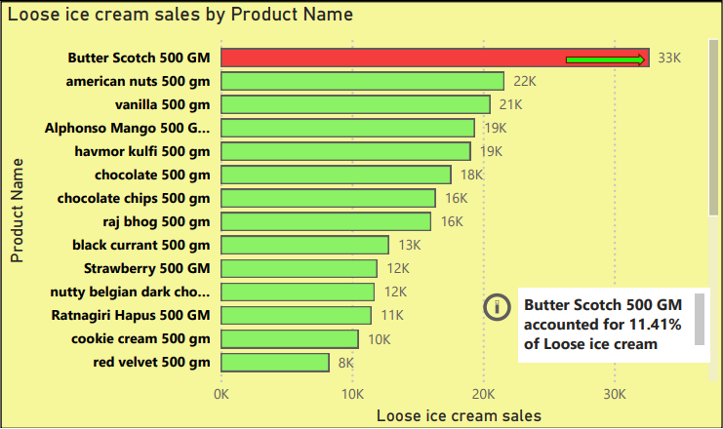
In the loose ice cream category – butter scotch 500 gm made the highest sales.

Slide 14
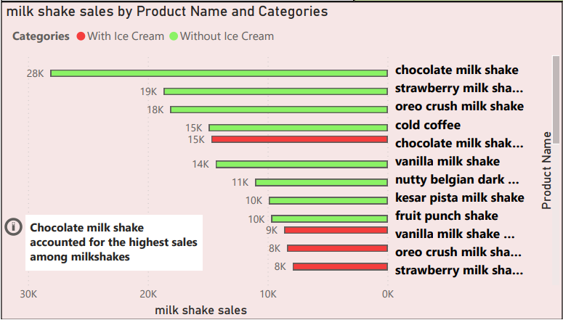
In the milk shake category – chocolate milk shake made the highest contribution.

Slide 15
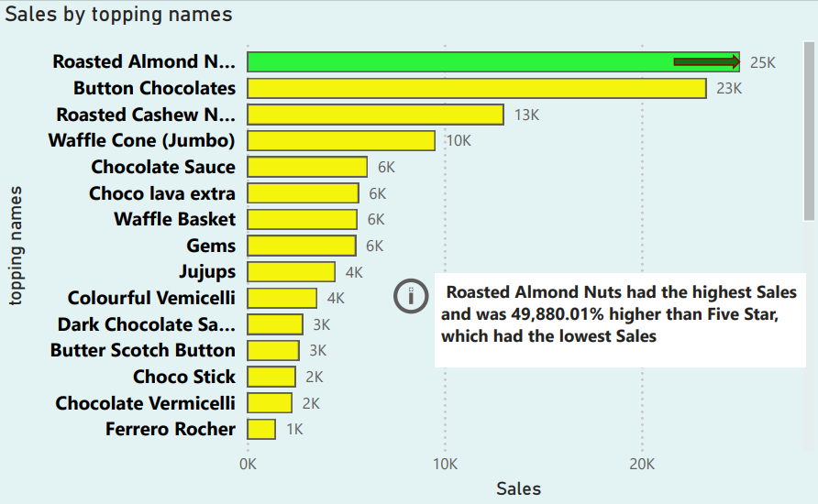
Sales by Topping Names

Slide 16
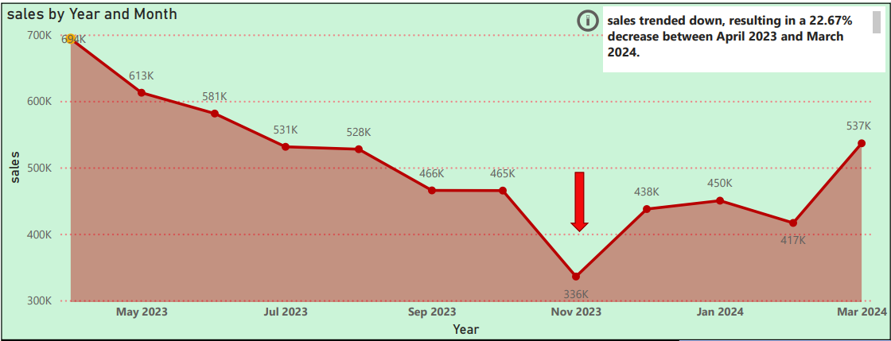
Sales trend for financial year 2023 (april23- march 24)
Sales peaked in april 2023 (694K) and showed a general downward trend

Slide 17
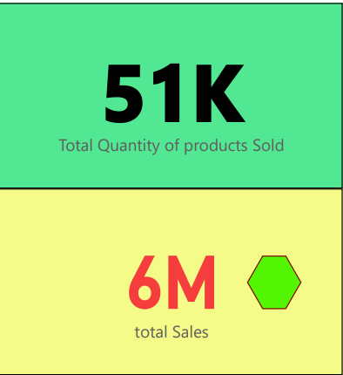
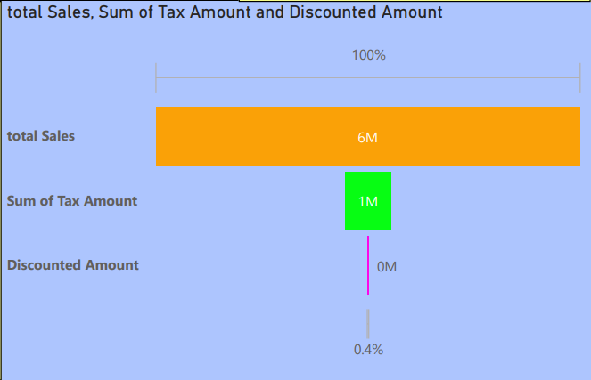
Total sales & total quantity of products sold

Slide 18
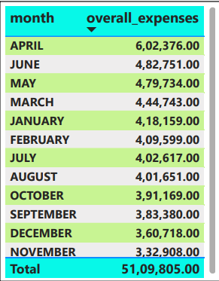
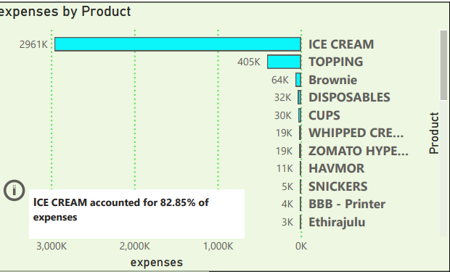
Expenses analysis:
APRIL month had the highest expenses made.
Procuring ice creams had the highest expense of nearly 3 million for the shop.

Slide 19
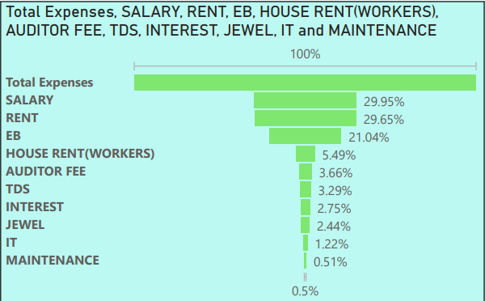
Expenses categories :

Slide 20
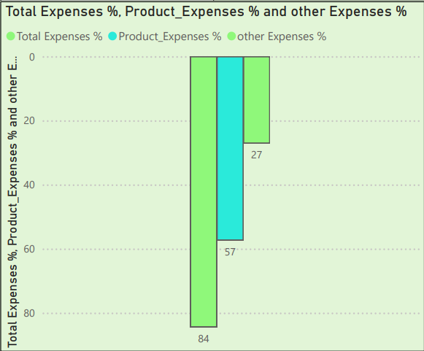
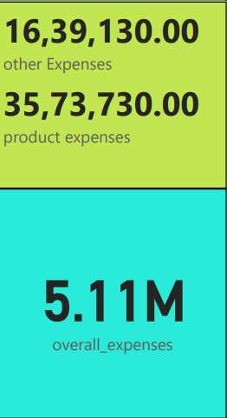
All the expenses % & amount

Slide 21
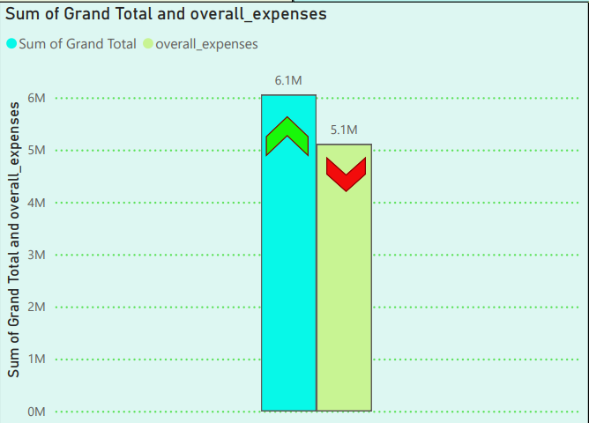
Total profit amount vs total expenses:

Slide 22
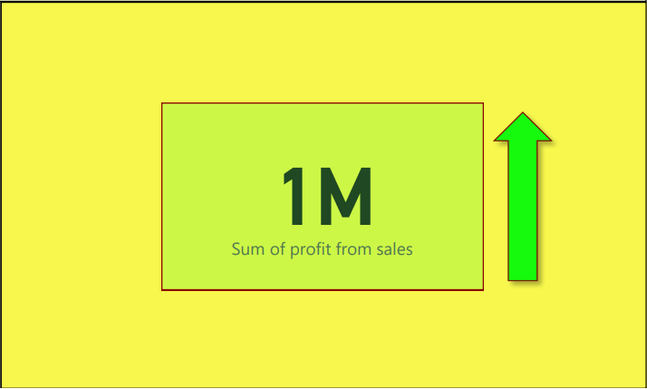
Total profit amount:

Slide 23
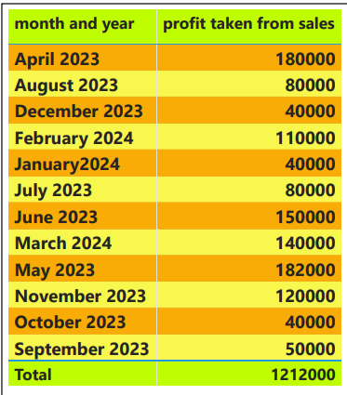
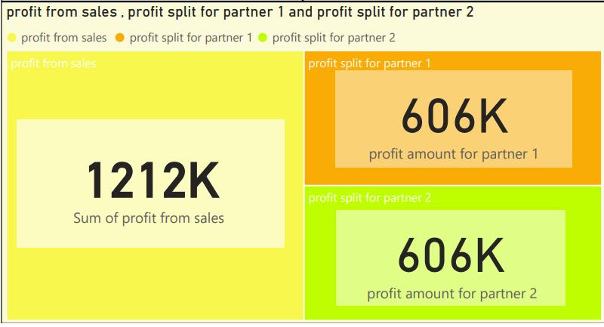
Profit taken from sales by each partner:

Slide 24
Conclusion:
Top Customers:
Orders: RUPA leads with the highest number of orders, indicating a strong and consistent demand from this customer.
Sales: Shajahan ranks highest in sales, showing substantial revenue generation from this customer
Sales Insights:
Product Category: Ice Cream Cake is the highest-selling category with total sales reaching 1.20M, suggesting it is the most popular product.
Individual Products: Choco Nutty Cone stands out as the top-selling product, driving significant sales of 451K.
Toppings: Roasted Almond Nuts is the most preferred topping, contributing notably to sales.
Revenue Contributions:
Products: Carry Bag (Large) shows the highest revenue contribution, highlighting the importance of ancillary products in overall revenue.
Sales Trends:
Monthly Trends: Sales peaked in april 2023 at 694K, followed by a gradual decline, indicating potential seasonal factors affecting sales.
Yearly Insights: General downward trend in sales points to the need for strategic interventions to boost performance.
Expense and Profit Analysis:
Expenses: Ice Cream accounts for 82.85% of total expenses, suggesting it is a major cost driver that requires careful management.
Profits: Profit peaked in April 2023 at 180K, indicating a successful period that can be analyzed for replicable strategies.

Slide 25
Recommendations:
Customer Focus:
Strengthen relationships with top customers like RUPA and Shajahan to maintain and enhance sales.
Product Strategy:
Leverage the popularity of Ice Cream Cake and Choco Nutty Cone by introducing promotional campaigns and new variations.
Optimize topping offerings by highlighting popular choices like Roasted Almond Nuts in marketing efforts.
Revenue Optimization:
Explore opportunities to increase sales of high revenue-contributing products such as Carry Bag (Large).
Sales Boosting Measures:
Investigate seasonal factors influencing sales peaks and troughs, and design targeted marketing campaigns to smooth out sales trends.
Cost Management:
Monitor and manage the high expenses associated with Ice Cream to improve overall profitability.
Conduct a detailed cost-benefit analysis to identify areas for cost reduction without compromising product quality.

Slide 26
Strategic actions:
Implement targeted marketing campaigns during peak sales months to capitalize on consumer behavior.
Introduce loyalty programs for top customers to encourage repeat business.
Optimize inventory and supply chain processes to reduce costs and improve efficiency.
- By following these recommendations and strategic actions , the business can enhance its sales performance, manage expenses more effectively, and ultimately improve profitability.

Slide 27

THANK YOU!

